Slide 1
Proof of Concept of Blockchain
Project Phase -4
Presentation By :
Palaash Atri (170110046)
Harsh Malik (170110022)
Pallavi (170110037)
CSE-CCV 3rd Year

Slide 2
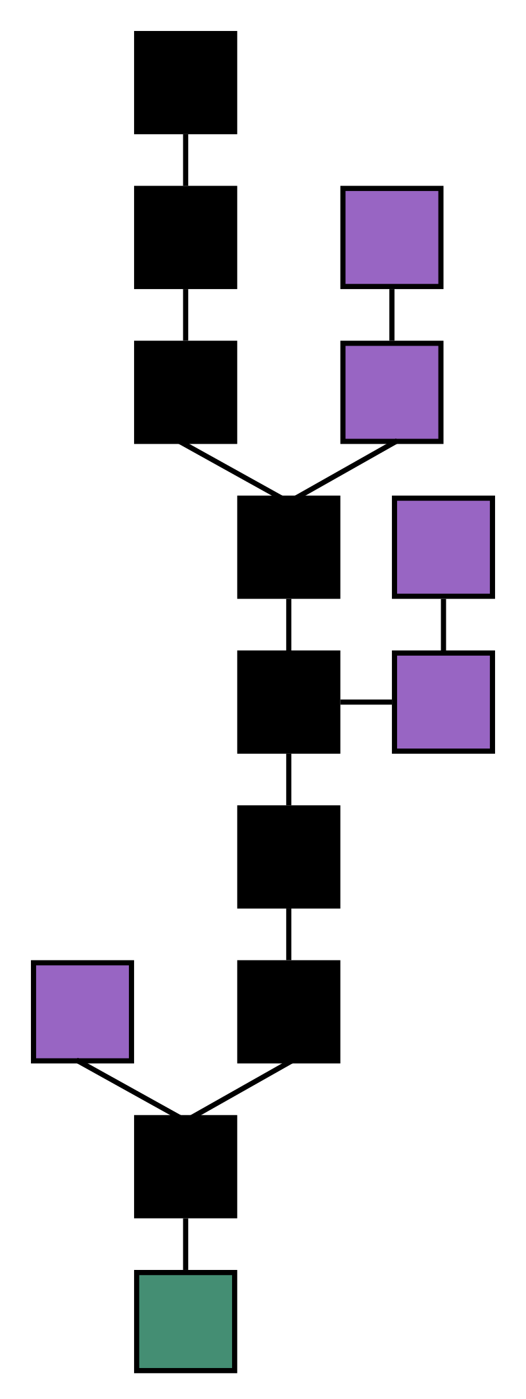
Introduction to Blockchain
Blockchain is a constantly growing ledger that keeps a permanent record of all the transactions that have taken place in a secure, chronological, and immutable way.
It can be used for the secure transfer of money, property, contracts, etc. without requiring a third-party intermediary such as bank or government.
Blockchain is a software protocol, but it could not be run without the Internet (like SMTP is for email).

Slide 3
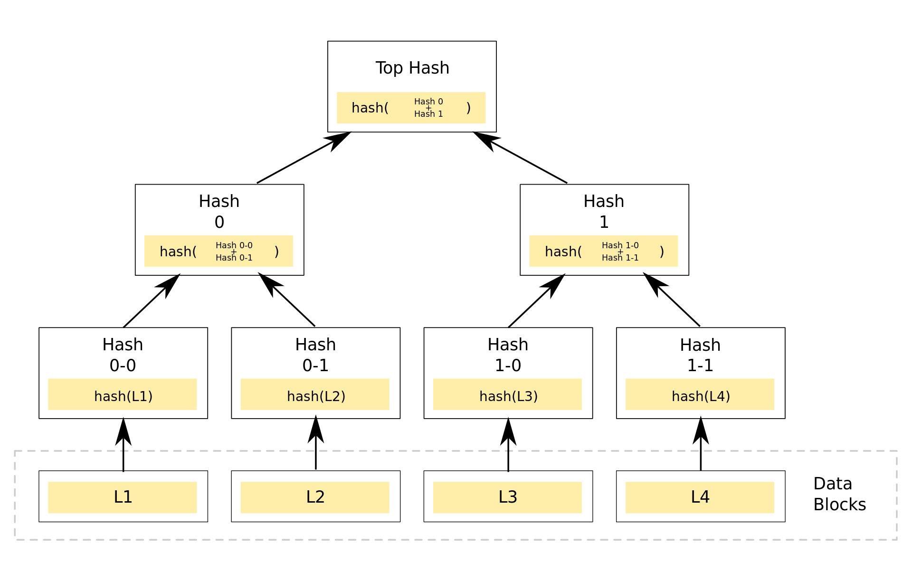
What exactly is a Blockchain?
At its core, a Blockchain is a collection of distributed and decentralized Ledgers, which store data as Transaction, which are then publicly shared across all Nodes of its network.
Blockchain is a chain of Blocks, which are basically the basic storage units of the blockchain that store all transactions.

Slide 4
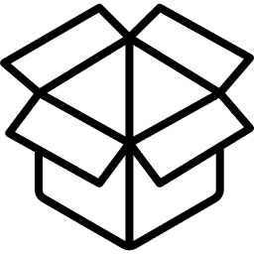
What are Blocks?
Blocks consist of a :
Data Field, which is used to store information in the Block itself,
Hash, a unique value consisting of a random string of characters, generated from Cryptographic Hash Functions, that generate a unique output for every unique input, and
LastHash, which basically contains the Hash of the Block that came before.
Data: [‘transact1’,’transact2’…]
Hash: 0x0009a891un12oie8982asnb…
lastHash: ‘hash-of-last-block’
Block

Slide 5
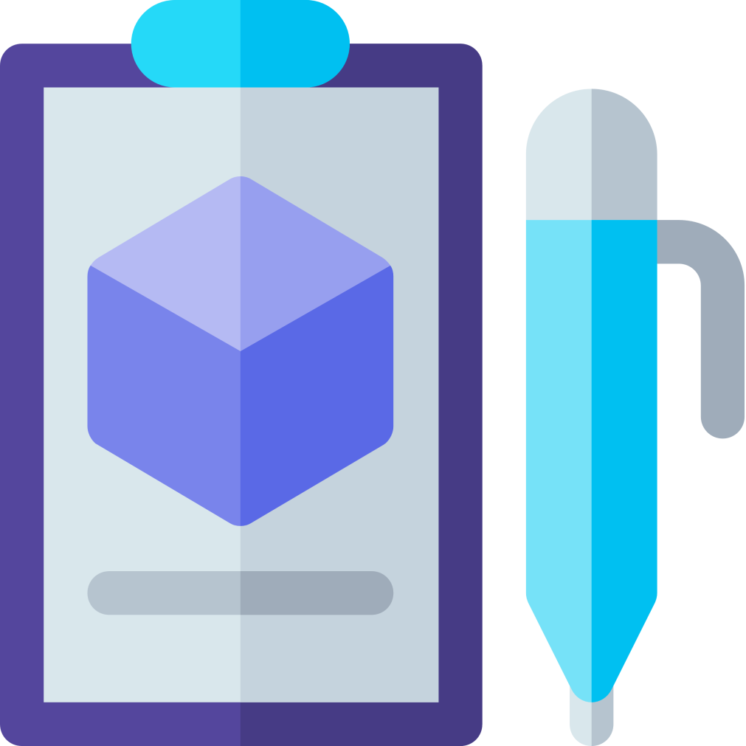
Ledger
A ledger is a record-keeping book, which contains a the records of all economic transactions of an organization.
It records payments, contracts, movements of assets etc. of an organization.
As a Ledger, the Blockchain serves the purpose of storing transactional data.
The Blockchain is a Distributed and Decentralized Ledger.

Slide 6


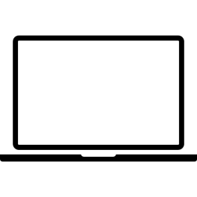
Distributed & Decentralized Ledger
As a Distributed Ledger, a Blockchain is typically managed by a peer-to-peer network collectively adhering to a protocol for inter-node communication and validating new blocks.
Once recorded, the data in any given block cannot be altered retroactively without alteration of all subsequent blocks, which requires consensus of the network majority.
Although blockchain records are not unalterable, blockchains may be considered secure by design and exemplify a distributed computing system with high fault tolerance.
Decentralized consensus has therefore been claimed with a blockchain.

Slide 7
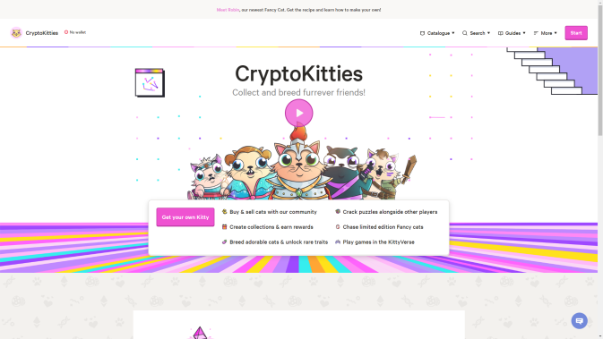
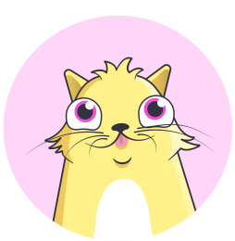
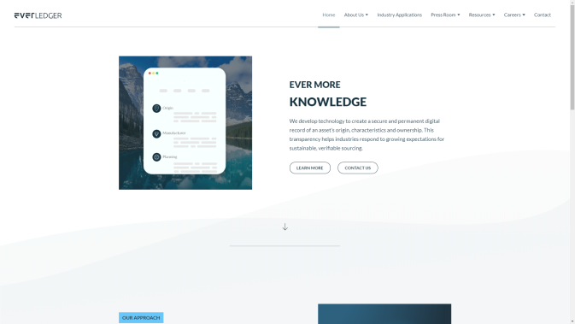

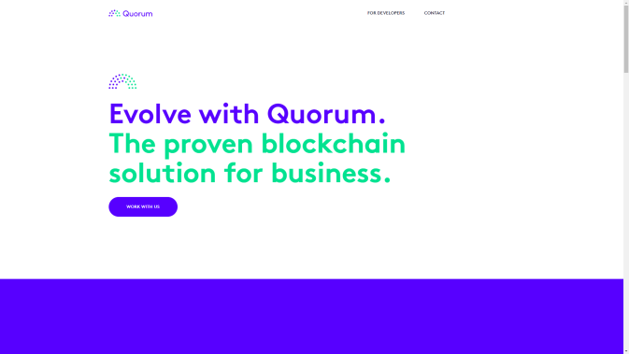

Uses of Blockchain
Blockchain technology can be integrated into multiple areas. The primary use of blockchains today is as a distributed ledger for cryptocurrencies, most notably bitcoin.
However, Blockchain is now being considered as a platform for multiple use-case scenarios, and multiple proof of concepts have been surfaced.
Blockchain is being used in the field of Video Games (CryptoKitties), Supply Chain (EverLedger), private storage (Quorum), and decentralized voting (Tezos).

Slide 8
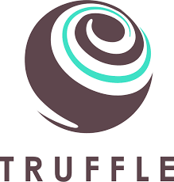
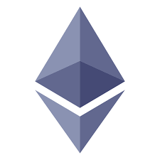

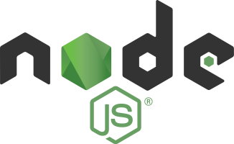
Tools and Technologies Used
Node.js v. 10.x
Solidity
Web3.js
Ganache (for setting up local development environment)
MetaMask (for transactions)
Ethereum Virtual Machine
Git – version control
Truffle Suite

Slide 9
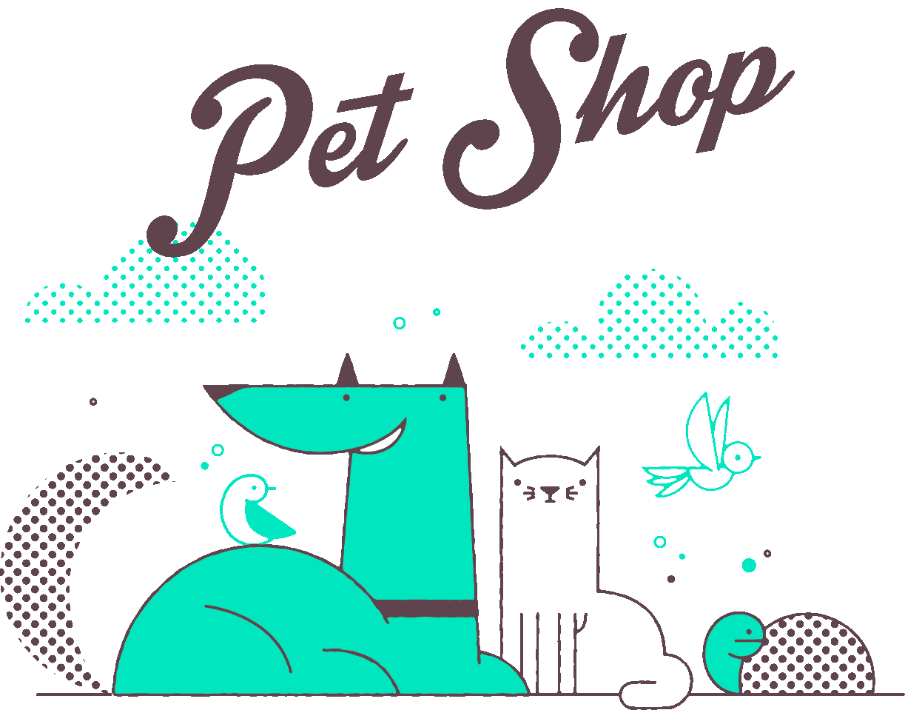
What we will be working on?
To show Proof of Concept (POC) of application of Blockchain, we will be working on Truffle Suite and Node.js to build a system that showcases how actual transactions work in a Blockchain.
For this, we’ll be building an app for adoption tracking system for a pet shop
The app will associate an Ethereum address with a pet to be adopted. Then certain functions will be used to depict the adoption of any pet.

Slide 10
Steps covered:
Setting up the development environment
Creating a Truffle project using a Truffle Box
Writing the smart contract
Compiling and migrating the smart contract
Testing the smart contract
Creating a user interface to interact with the smart contract
Interacting with the dapp in a browser

Slide 11
Setting up the development environment
Installing Node.js and NPM : Download from https://nodejs.org/en/download/
Installing Git : Download from https://git-scm.com/downloads
Installing Truffle : npm install -g truffle
Installing Ganache : Download from http://truffleframework.com/ganache

Slide 12
Creating a Truffle project using a Truffle Box
Truffle Boxes are helpful boilerplates that allow you to focus on what makes your dapp unique. In addition to Truffle, Truffle Boxes can contain other helpful modules, Solidity contracts & libraries, front-end views and more; all the way up to complete example dapps.
The truffle box we’ve used here is the “pet-shop” box which is unboxed in the development directory.

Slide 13
Writing the smart contract
A smart contract is a computer protocol intended to digitally facilitate, verify, or enforce the negotiation or performance of a contract. Smart contracts allow the performance of credible transactions without third parties. These transactions are trackable and irreversible.
These contracts have been written in Solidity programming language.
Solidity is the main programming language for writing smart contracts for the Ethereum blockchain. It is a contract-oriented language, which means that smart contracts are responsible for storing all of the programming logic that transacts with the blockchain.

Slide 14
Compiling and migrating the smart contract
A migration is a deployment script meant to alter the state of your application's contracts, moving it from one state to the next. For the first migration, we might just be deploying new code, but over time, other migrations might move data around or replace a contract with a new one.
Before we can migrate our contract to the blockchain, we need to have a blockchain running. For this tutorial, we're going to use Ganache.
Once we’ve generated the blockchain, we’ll migrate our contracts to the blockchain.

Slide 15
Testing the smart contract
Truffle is very flexible when it comes to smart contract testing, in that tests can be written either in JavaScript or Solidity. Here, we’ve used Solidity.
Here, we’ve tested the following functions:
1. Testing the adopt() function
2. Testing retrieval of a single pet's owner
3. Testing retrieval of all pet owners

Slide 16
Creating a user interface to interact with the smart contract
Now that we've created the smart contract, deployed it to our local test blockchain and confirmed we can interact with it via the console, it's time to create a UI.
First, we’ll instantiate web3 to interact with Ethereum through MetaMask extension on our web browser.
Now, we need to instantiate our smart contract so web3 knows where to find it and how it works.
Truffle has a library to help with this called truffle-contract. It keeps information about the contract in sync with migrations, so you don't need to change the contract's deployed address manually.

Slide 17
Interacting with the dapp in a browser
Now that we’re ready to use our dapp, we configure the MetaMask in Chrome.
Once configured, we can run our local web server and interact with our pet shop to adopt pets easily.

Slide 18
THANK YOU!

